Slide 1
CIGFARO FMCMM master class
PRESENTATION BY MALESELA LANGA
15 APRIL 2024

Slide 3

WEB-ENABLED SYSTEM
  Session 1: Audit Action Plan
  Session 2: FMCMM 123
  Session 3: MP Status

Slide 4
SESSION 1: AUDIT ACTION PLAN

Slide 5
BENEFITS OF WEB-ENABLED AAP
1.
2.
Approval process
is embedded in
the system
3.
Allows multiple users
to access and work
on the AAP
Standardized
format
4.
Provides for e-mail
alerts
5.
Real time Progress
tracking
6.
Quality assurance
7.
Improved
accountability
8.
Filtering of relevant
information
9.
NT/PT have access
to real time
information

Slide 6
AUDIT ACTION PLAN PROCESSES
01
Audit Action Plan Approval
02
Implementation Status

Slide 7
AUDIT ACTION PLAN APPROVAL
PROCESS
Developed
(Council Approved)
Developed
(Audit Committee Assurance)
7
Developed
(Internal Audit Assurance)
6
Council
Developed
(CFO Approved)
5
Audit Committee
Developed
(Management Approved)
4
Internal Audit
Under Development
3
CFO
Not Yet Started
2
Management
1
Responsible
Person
Audit Champion
Not Yet Started

Slide 8
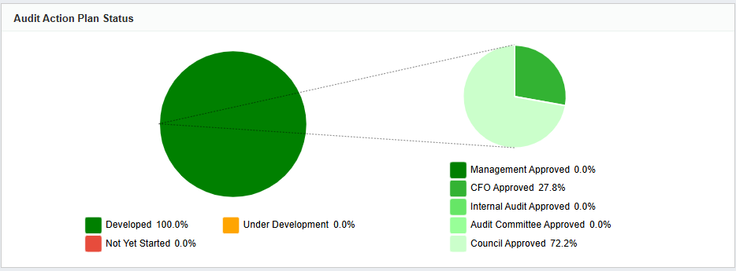
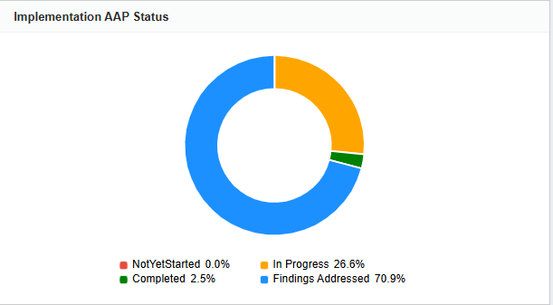
AUDIT ACTION PLAN DASHBOARD

Slide 9
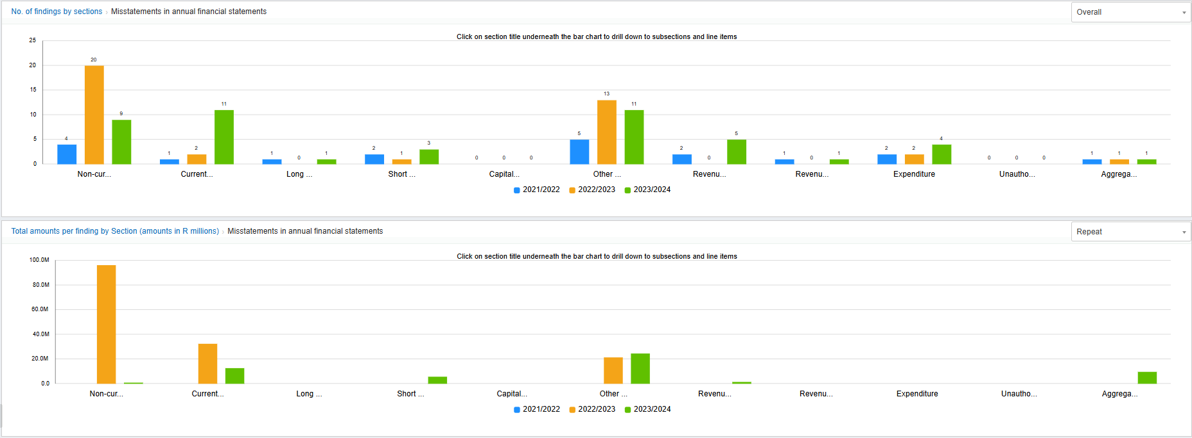
AUDIT ACTION PLAN DASHBOARD
Municipal portal: Summary of number of repeat findings by section and by amount.

Slide 10
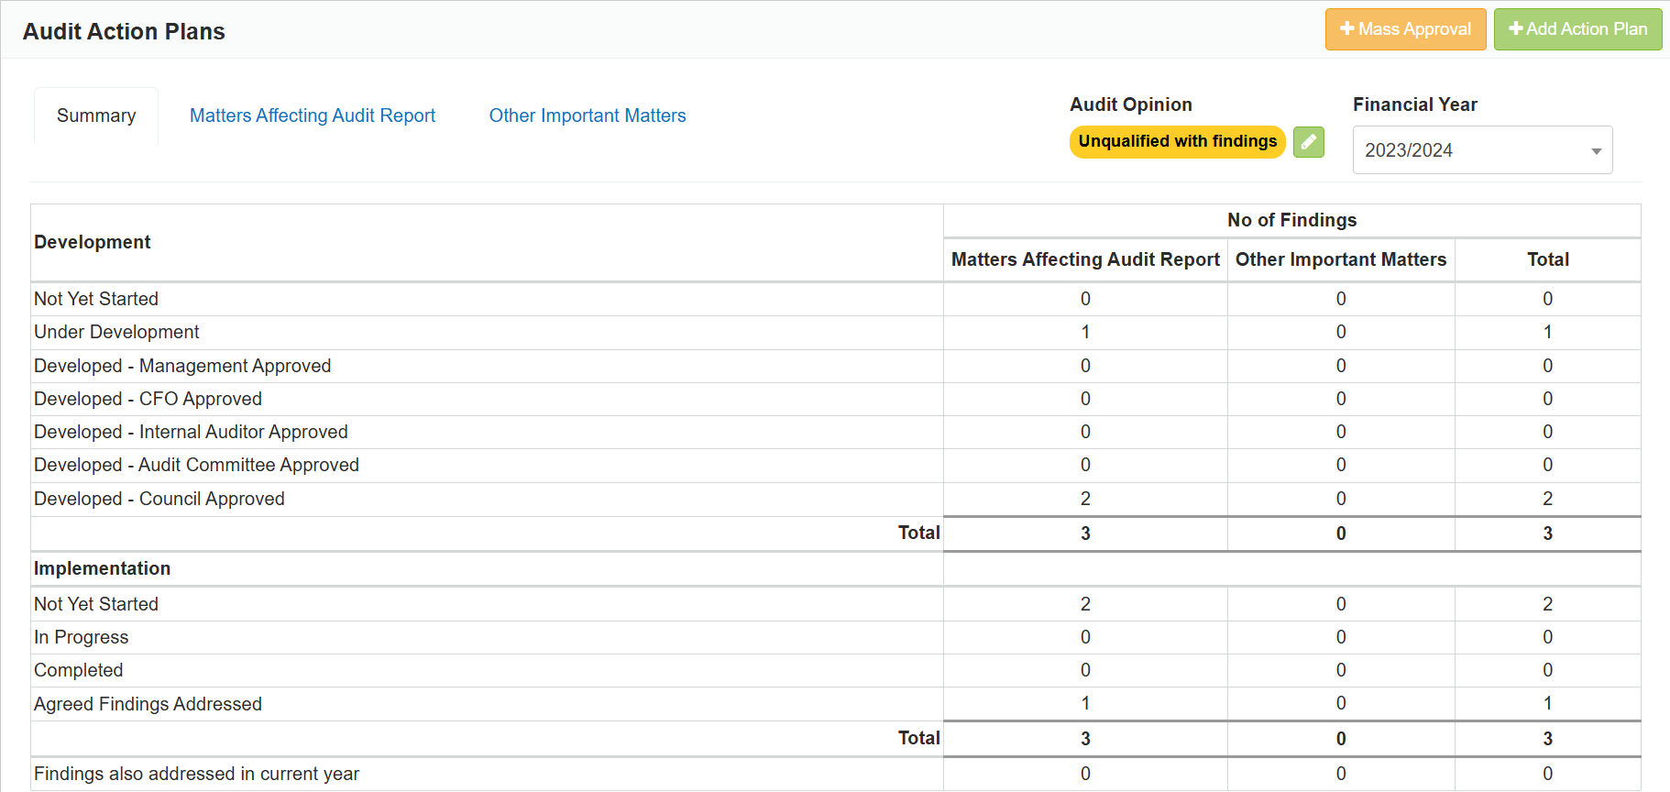
AUDIT ACTION PLAN SUMMARY

Slide 11
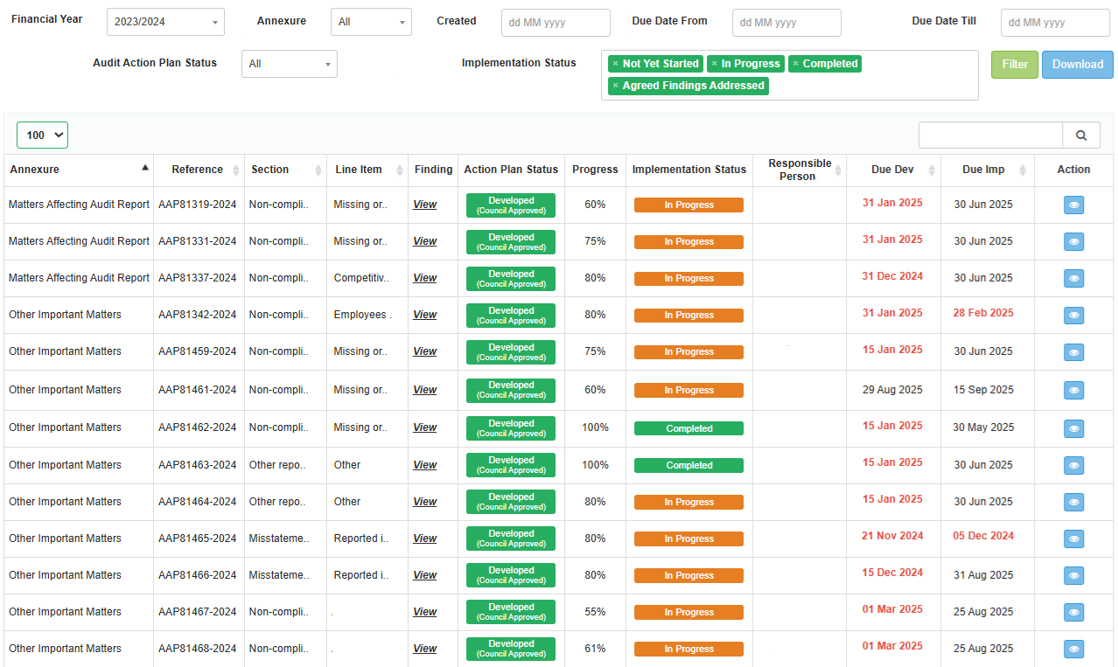
DETAILED TRACKING

Slide 12
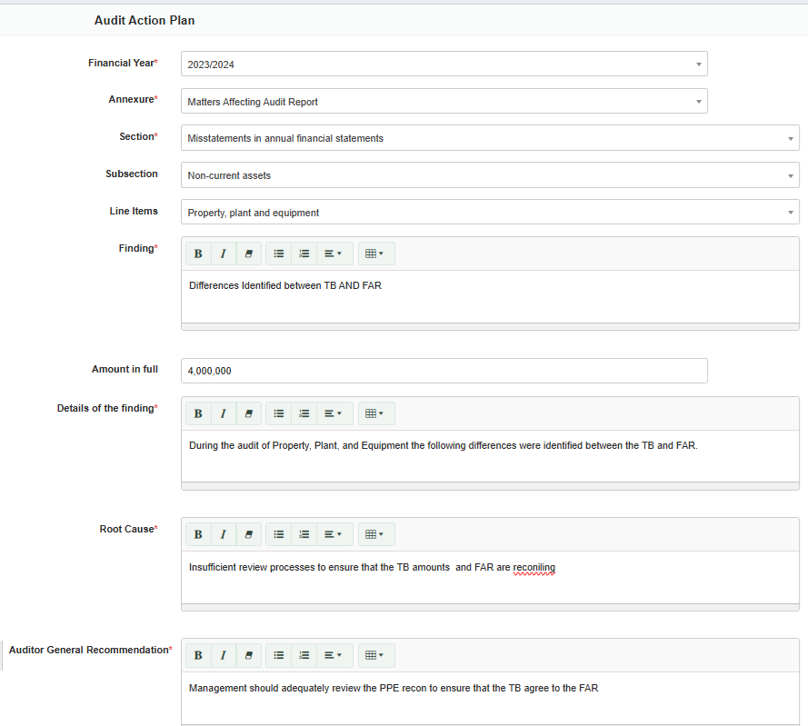
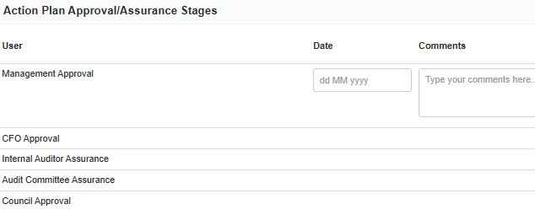

USER FRIENDLY & SMART
Alignment with AGSA audit and management reports.
Copy and paste functionality.
Dropdown menus for easy and accurate selection.
Recurring findings are identified for special attention.
Accountability is ensured by allocating tasks to specific individuals.
Built in approvals by Management, CFO, Internal audit.
Allows for comments at various stages.
Audit trail enabled.
Consideration of NT/PT recommendations is required.

Slide 13
AUDIT ACTION PLAN IMPLEMENTATION
01
Update % completion
05
02
Document Implementation progress
04
03
03
Attach POE
02
04
If % is 100% then click complete
01
05
Internal Audit Review
1. Not Yet Started
2. In progress
3. Completed
4.Agreed finding addressed

Slide 14
REPORTS
Dashboard
Detailed audit action plan (Excel and PDF)
FMCMM Report (Maturity level trends)

Slide 15
AUDIT ACTION PLAN:
SYSTEM DEMONSTRATION
https://trainingfmcmm.treasury.gov.za/login

Slide 16
SESSION 2: FMCMM

Slide 17

OBJECTIVE OF THE FMCMM
The tools were designed to assess and improve the level of financial management maturity and capabilities within municipalities. They aim to:
  Provide information that would assist management to implement changes to address shortcomings;
  Improve and develop practices for good financial management;
  Identify risks prevalent in the system and introduce mitigation measures to address them;
  Help to sustain procedures and processes for effective and efficient financial management; and
  Serve as a proactive mechanism that would support improvements in financial management and contribute towards better audit outcomes.
To guide municipalities in continuous improvement and innovation of sustainable financial management towards effective, efficient and economical service delivery excellence.

Slide 18
FMCMM Completion
C
Ready for
audit
B
D
H
Outstanding
Maturity
Level
Completed
Audited by
Internal
Audit
Open
Reviewed
A
E
G
Submitted
F

Slide 19
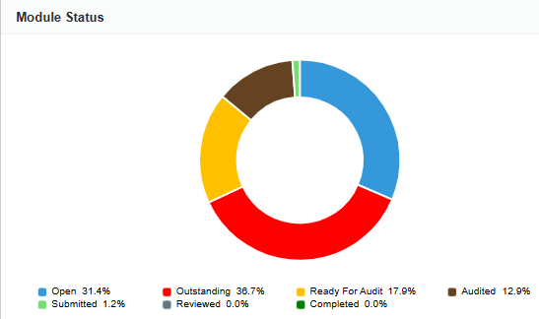
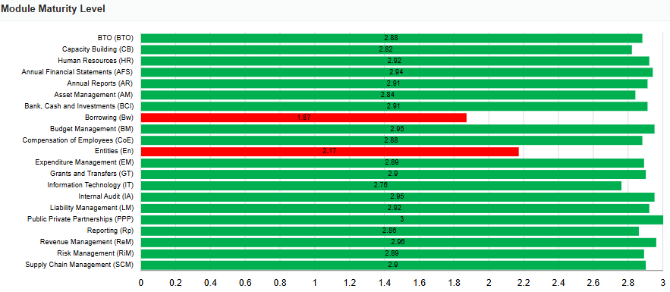
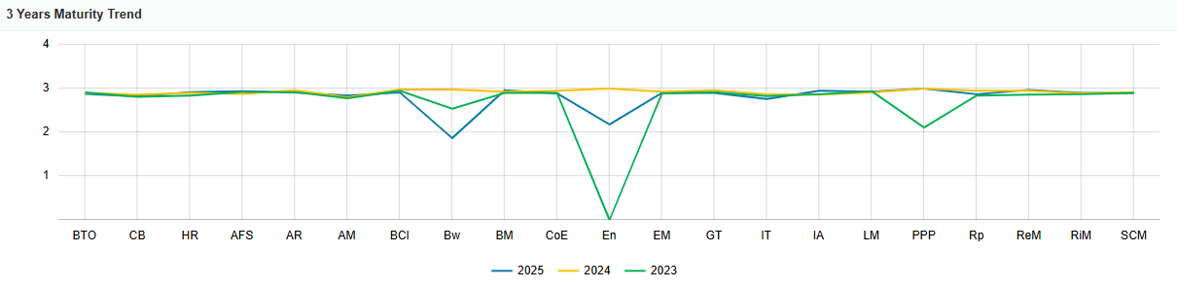
FMCMM DASHBOARD

Slide 20
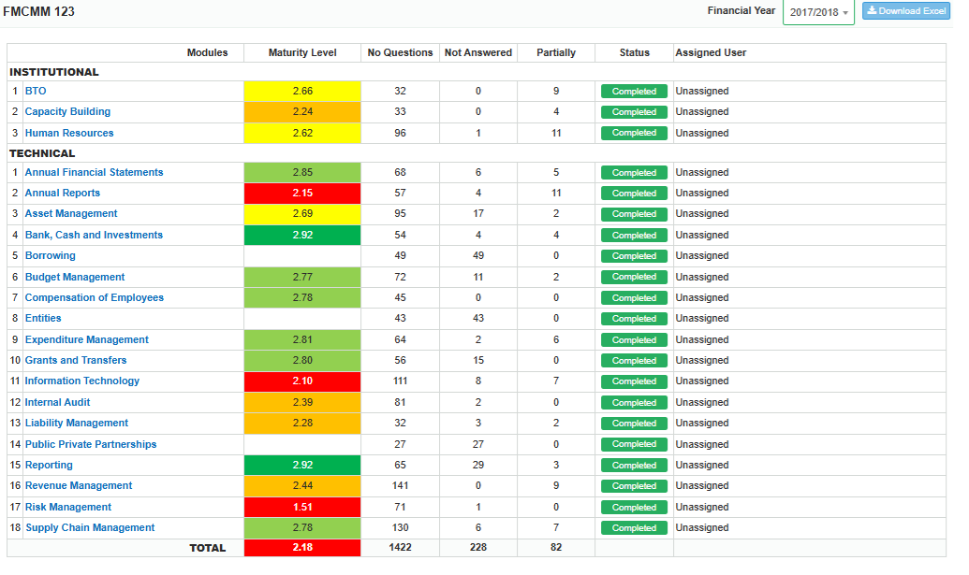
FMCMM 123

Slide 21
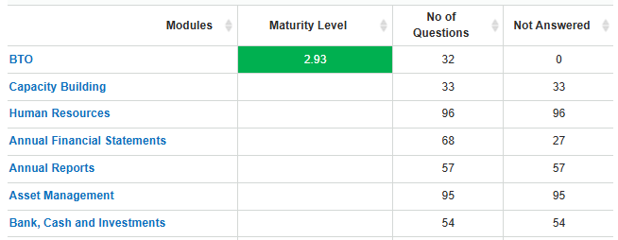

FMCMM 123
For Questions answered “No” or “Partial > Develop FMCMM action plan

Slide 22
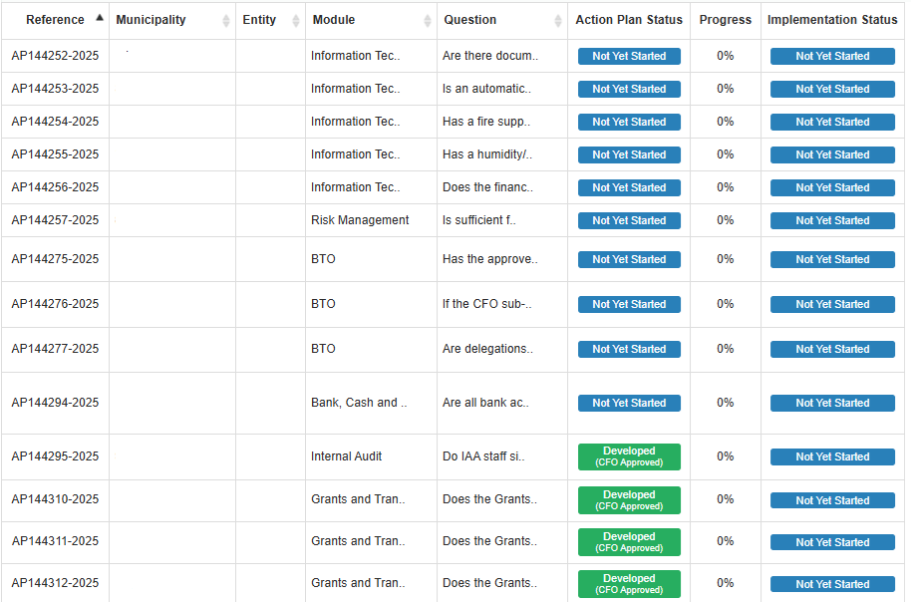
FMCMM 123

Slide 23
FMCMM:
SYSTEM DEMONSTRATION
https://trainingfmcmm.treasury.gov.za/login

Slide 24
SESSION 3: MP STATUS

Slide 25
AUDIT ACTION PLAN STATUS
District | Municipality | Total Number of Findings | Approved by Council | %
Ehlanzeni | Ehlanzeni | 10 | 10 | 100%
Ehlanzeni | Thaba Chweu | 70 | 70 | 100%
Ehlanzeni | City of Mbombela | 65 | 65 | 100%
Nkangala | Nkangala | 7 | 7 | 100%
Nkangala | Thembisile Hani | 62 | 62 | 100%
Nkangala | Victor Khanye | 22 | 22 | 100%
Gert Sibande | Gert Sibande | 38 | 38 | 100%
Gert Sibande | Dr Pixley Ka Isaka Seme | 70 | 70 | 100%
Gert Sibande | Govan Mbeki | 79 | 79 | 100%
Gert Sibande | Lekwa | 117 | 90 | 77%
Nkangala | Dr JS Moroka | 51 | 38 | 75%
Ehlanzeni | Bushbuckridge | 79 | 57 | 72%
Gert Sibande | Mkhondo | 27 | 19 | 70%
Gert Sibande | Msukaligwa | 41 | 26 | 63%
Ehlanzeni | Nkomazi | 69 | 0 | 0%
Nkangala | Emakhazeni | 13 | 0 | 0%
Nkangala | Emalahleni | 24 | 0 | 0%
Nkangala | Steve Tshwete | 45 | 0 | 0%
Gert Sibande | Chief Albert Luthuli | 66 | 0 | 0%
Gert Sibande | Dipaleseng | 142 | 0 | 0%

Slide 26
FMCMM STATUS
District | Municipality | Open | Outstanding | Ready for Audit | Audited by IA | Submitted
Ehlanzeni | Bushbuckridge | 0 | 16 | 5 | 0 | 0
Gert Sibande | Chief Albert Luthuli | 0 | 13 | 0 | 8 | 0
Ehlanzeni | City of Mbombela | 0 | 2 | 19 | 0
Gert Sibande | Dipaleseng | 0 | 19 | 2 | 0 | 0
Nkangala | Dr JS Moroka | 0 | 21 | 0 | 0 | 0
Gert Sibande | Dr Pixley Ka Isaka Seme | 0 | 10 | 11 | 0 | 0
Ehlanzeni | Ehlanzeni | 2 | 14 | 1 | 4 | 0
Nkangala | Emakhazeni | 2 | 12 | 7 | 0 | 0
Nkangala | Emalahleni | 21 | 0 | 0 | 0 | 0
Gert Sibande | Gert Sibande | 21 | 0 | 0 | 0 | 0
Gert Sibande | Govan Mbeki | 21 | 0 | 0 | 0 | 0
Gert Sibande | Lekwa | 0 | 9 | 10 | 0 | 2
Gert Sibande | Mkhondo | 2 | 12 | 5 | 1 | 1
Gert Sibande | Msukaligwa | 0 | 9 | 12 | 0 | 0
Nkangala | Nkangala | 0 | 2 | 2 | 17 | 0
Ehlanzeni | Nkomazi | 21 | 0 | 0 | 0 | 0
Nkangala | Steve Tshwete | 21 | 0 | 0 | 0 | 0
Ehlanzeni | Thaba Chweu | 0 | 0 | 0 | 21 | 0
Nkangala | Thembisile Hani | 0 | 15 | 1 | 3 | 2
Nkangala | Victor Khanye | 0 | 21 | 0 | 0 | 0

Slide 27
CHALLENGES
  Audit action plans not approved by Council.
  Audit action plans completed with no progress documented.
  Audit action plans completed with no POE attached.
  Audit action plans at 100% but status remain in progress.
  Audit action plans signed off by IA with no progress and/or POE.

Slide 28
END

